Slide 1
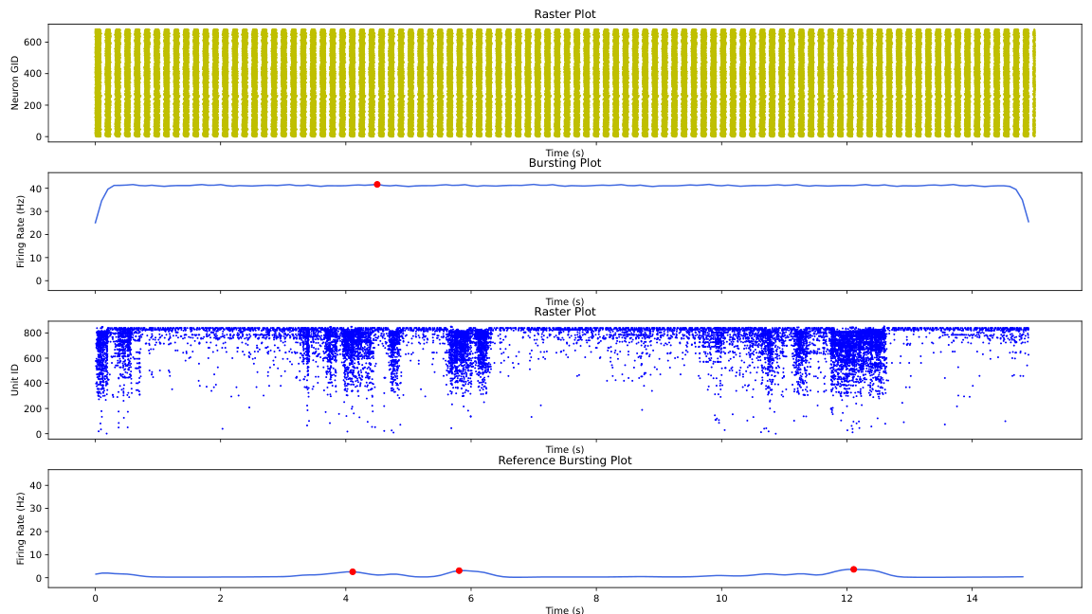
gen_1_cand_7
Candidate: gen_1_cand_7
Avg Fitness: 1000

Slide 2
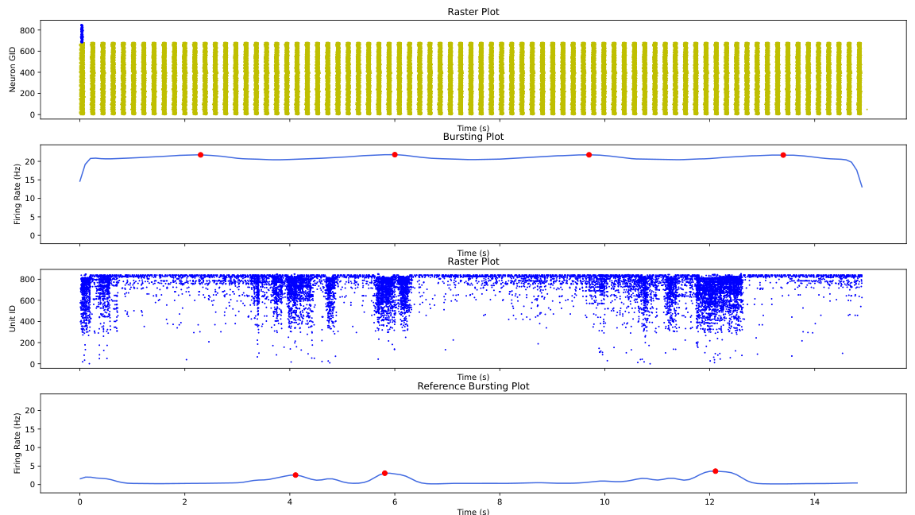
gen_1_cand_84
Candidate: gen_1_cand_84
Avg Fitness: 754.482227484505

Slide 3
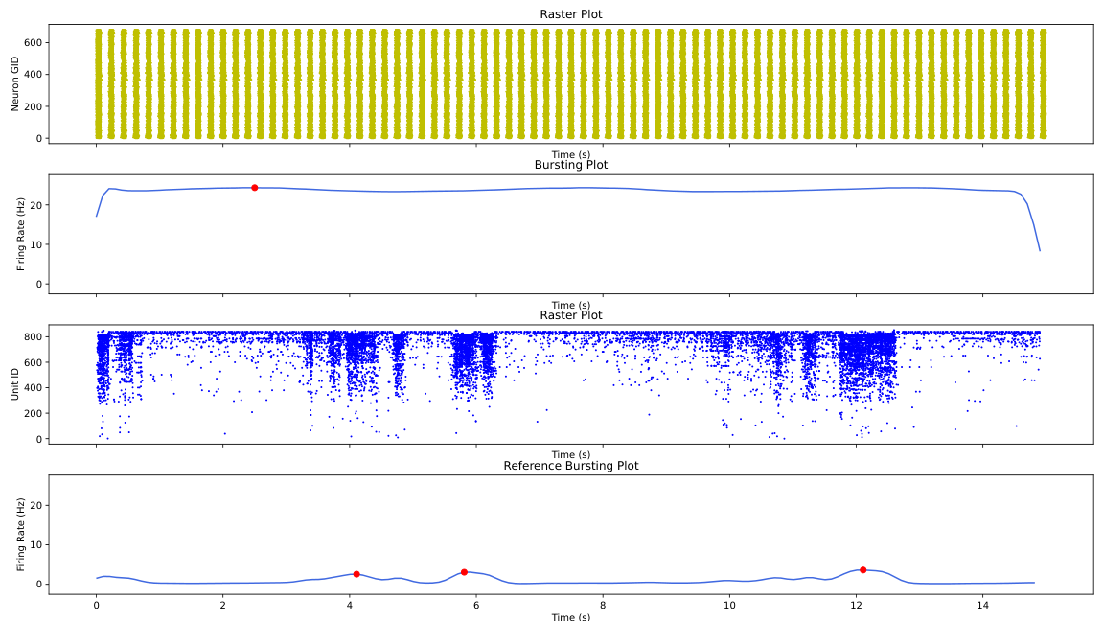
gen_1_cand_25
Candidate: gen_1_cand_25
Avg Fitness: 1000

Slide 4
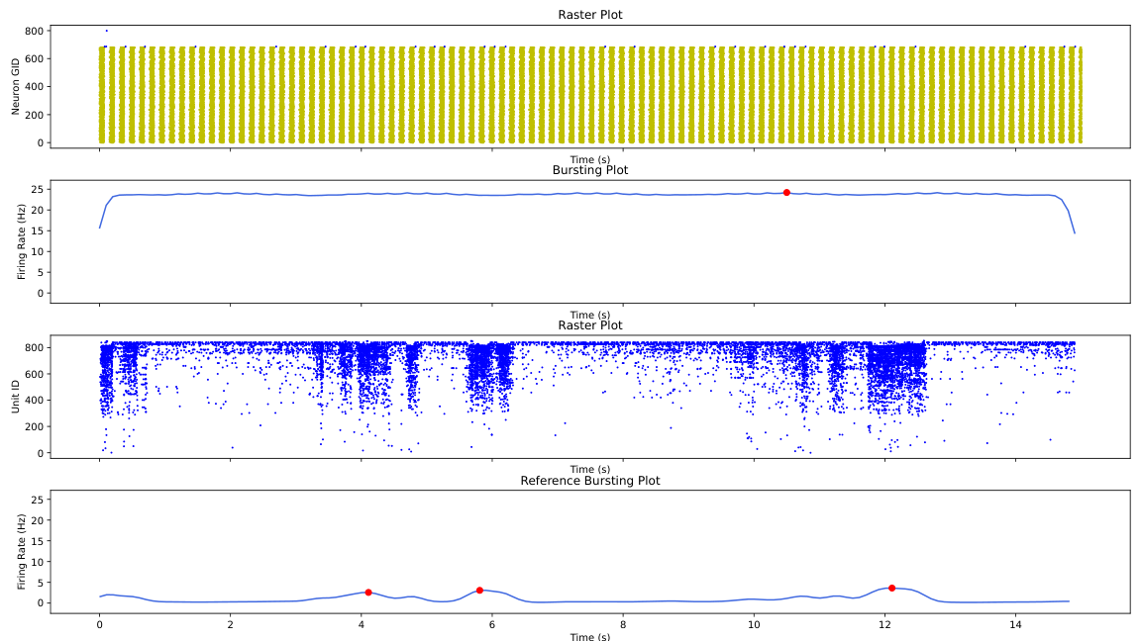
gen_1_cand_18
Candidate: gen_1_cand_18
Avg Fitness: 1000

Slide 5
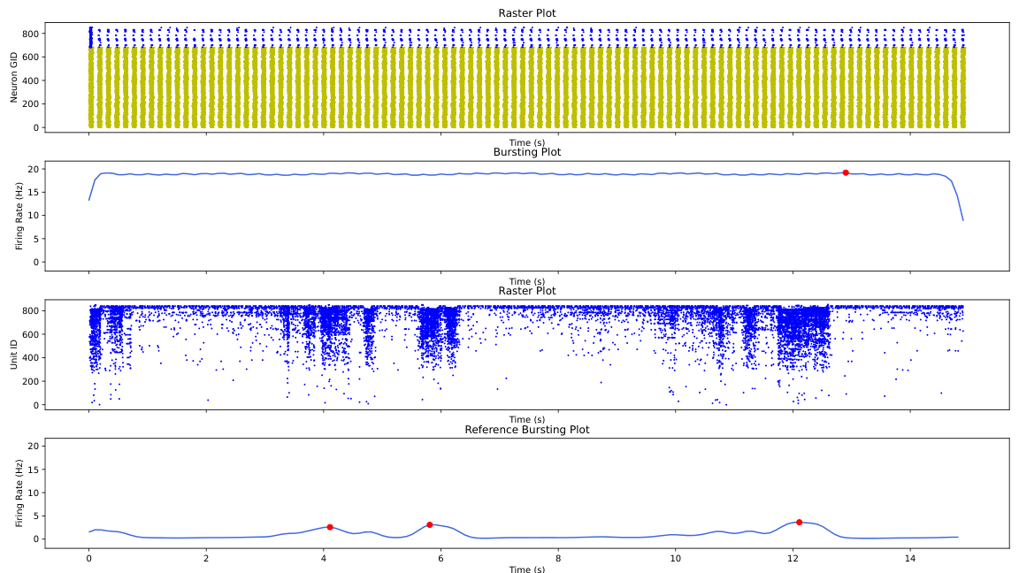
gen_1_cand_58
Candidate: gen_1_cand_58
Avg Fitness: 1000

Slide 6
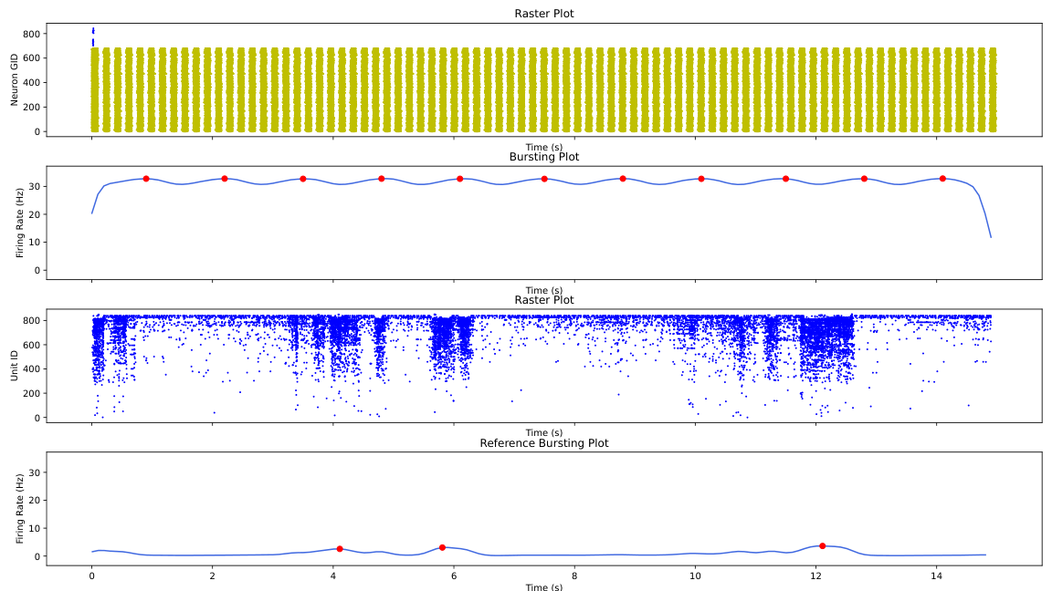
gen_1_cand_77
Candidate: gen_1_cand_77
Avg Fitness: 1000

Slide 7
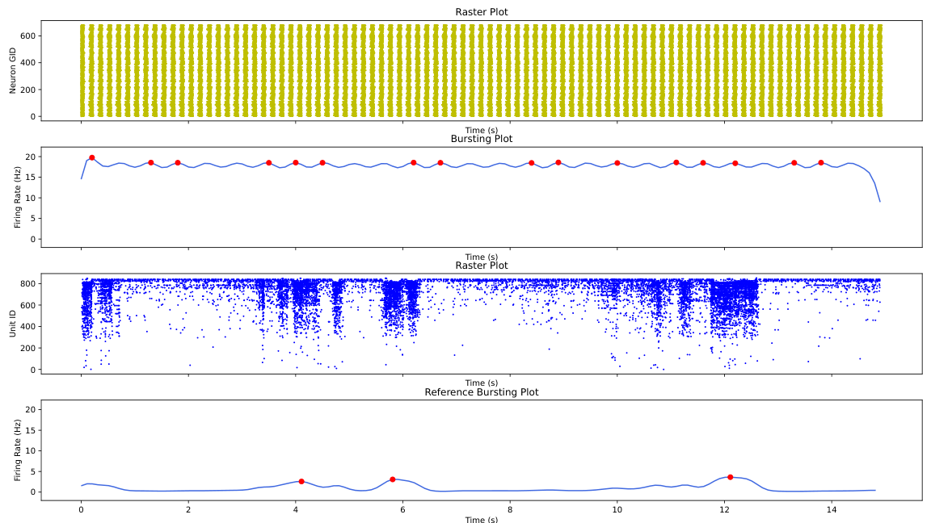
gen_1_cand_67
Candidate: gen_1_cand_67
Avg Fitness: 1000

Slide 8
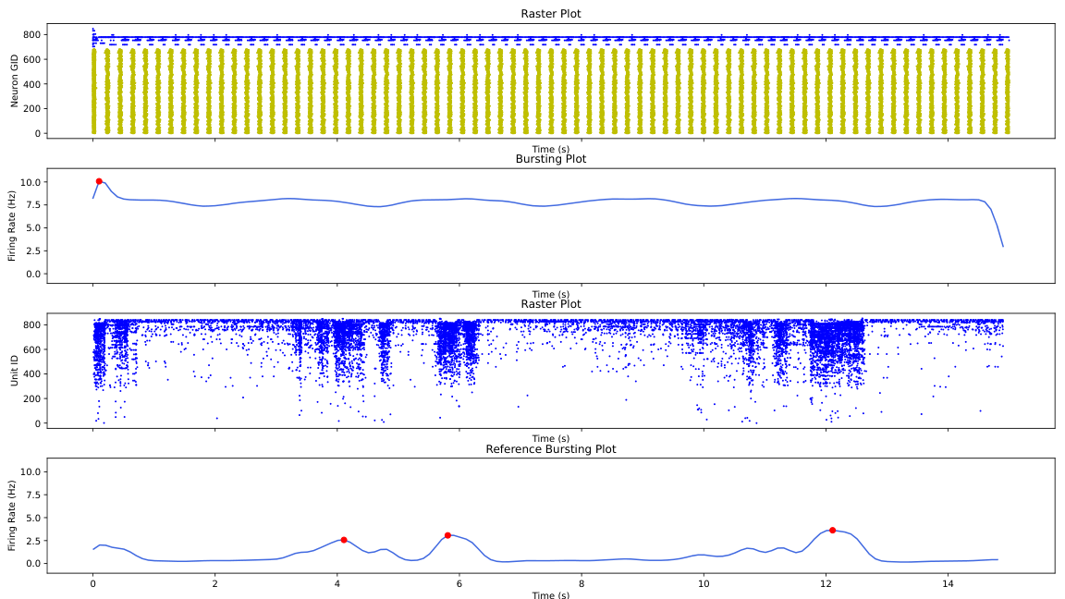
gen_1_cand_26
Candidate: gen_1_cand_26
Avg Fitness: 626.8038670674207

Slide 9
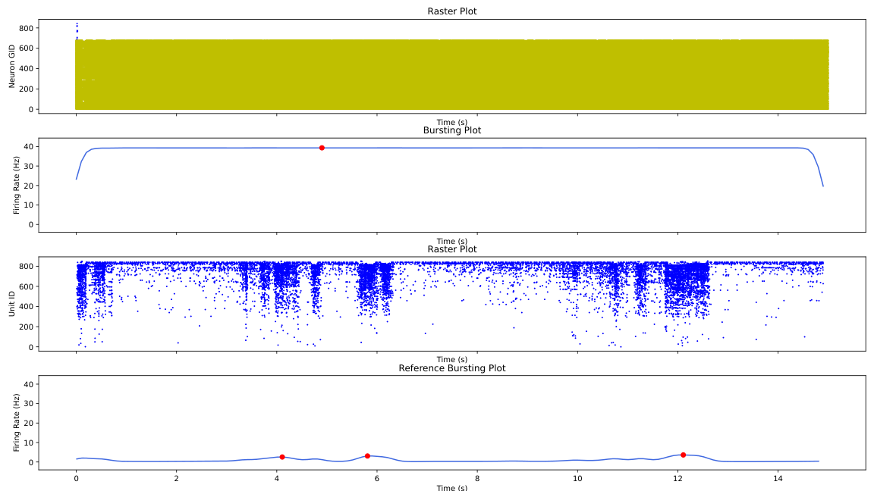
gen_1_cand_33
Candidate: gen_1_cand_33
Avg Fitness: 809.9650030541183

Slide 10
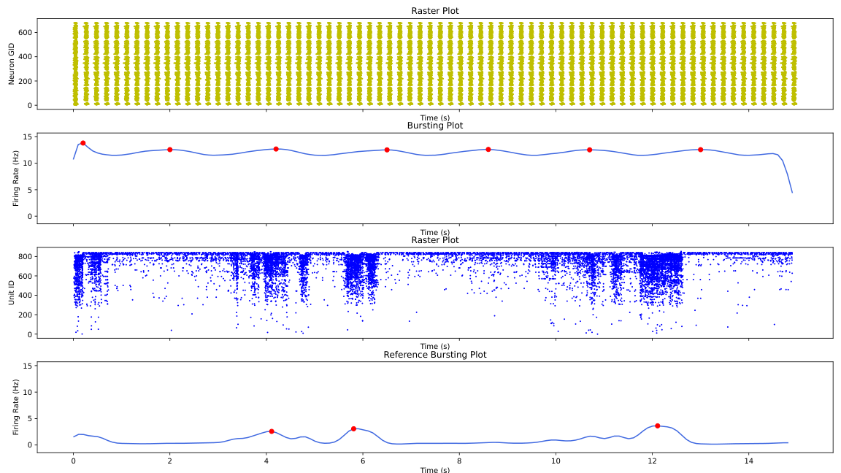
gen_1_cand_97
Candidate: gen_1_cand_97
Avg Fitness: 764.0244374399066

Slide 11

gen_1_cand_20
Candidate: gen_1_cand_20
Avg Fitness: 583.698114927881

Slide 12

gen_1_cand_46
Candidate: gen_1_cand_46
Avg Fitness: 1000

Slide 13
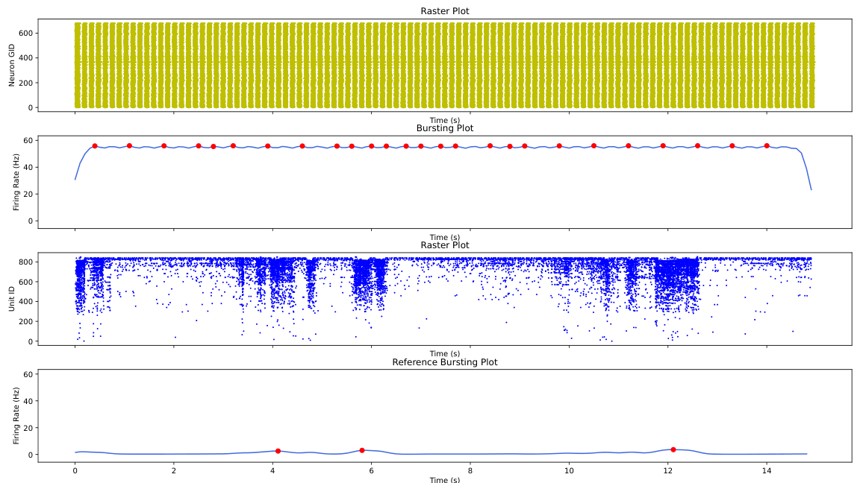
gen_1_cand_65
Candidate: gen_1_cand_65
Avg Fitness: 795.4559594770325

Slide 14
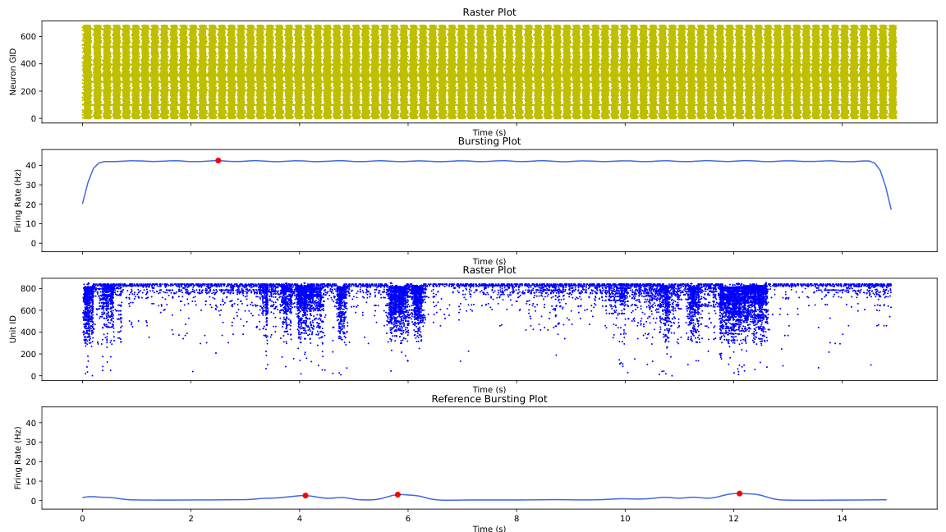
gen_1_cand_41
Candidate: gen_1_cand_41
Avg Fitness: 1000

Slide 15
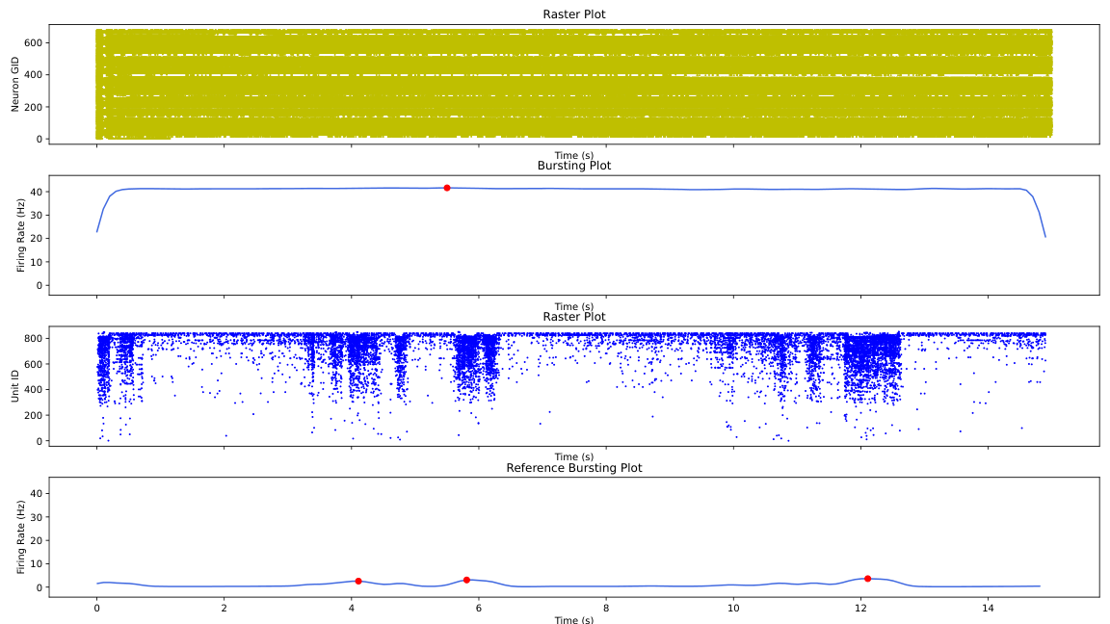
gen_1_cand_10
Candidate: gen_1_cand_10
Avg Fitness: 1000

Slide 16
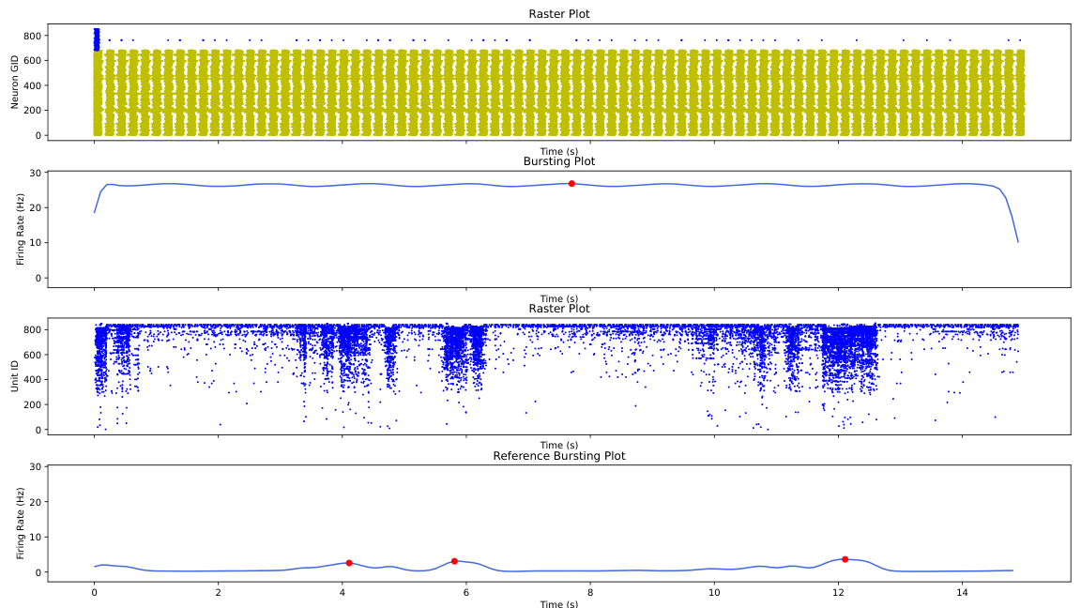
gen_1_cand_76
Candidate: gen_1_cand_76
Avg Fitness: 762.5281017939875

Slide 17

gen_1_cand_17
Candidate: gen_1_cand_17
Avg Fitness: 839.3064098684692

Slide 18
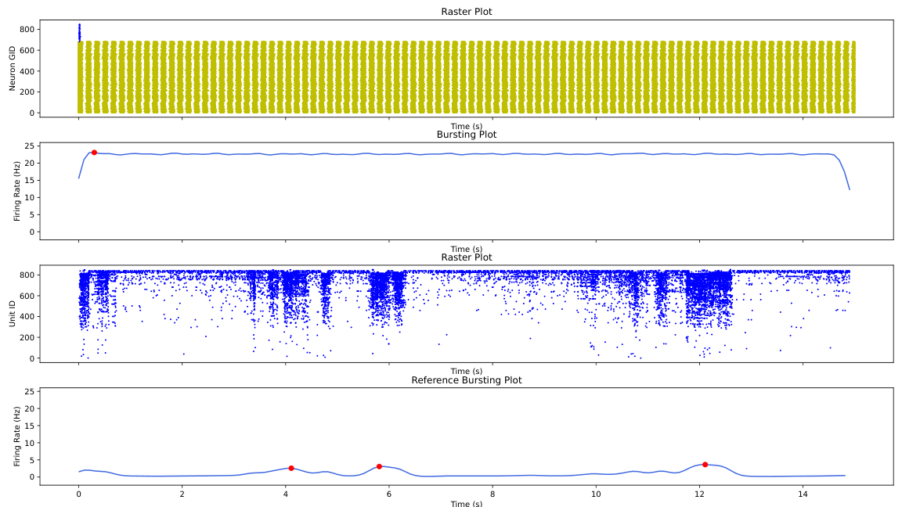
gen_1_cand_63
Candidate: gen_1_cand_63
Avg Fitness: 1000

Slide 19

gen_1_cand_2
Candidate: gen_1_cand_2
Avg Fitness: 527.4566658602399

Slide 20
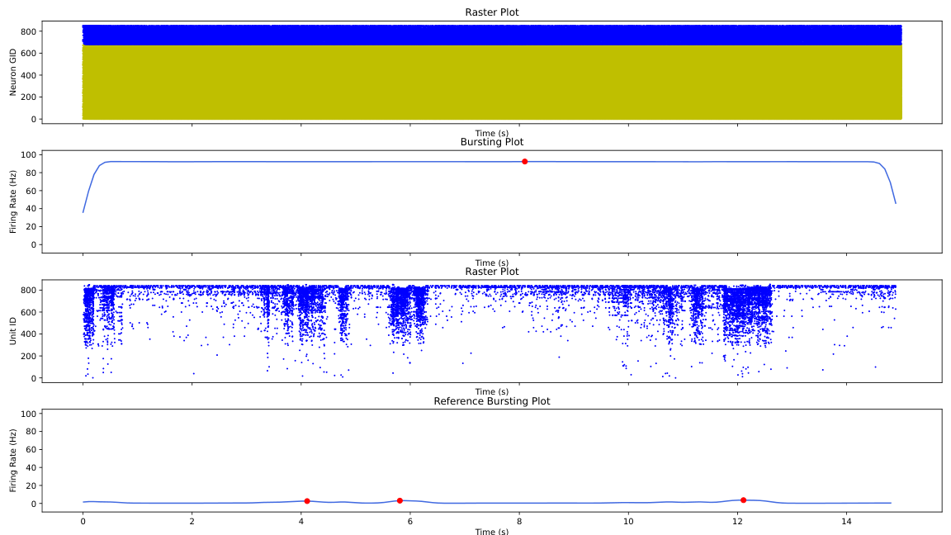
gen_1_cand_42
Candidate: gen_1_cand_42
Avg Fitness: 490.20731862334503

Slide 21

gen_1_cand_83
Candidate: gen_1_cand_83
Avg Fitness: 1000

Slide 22
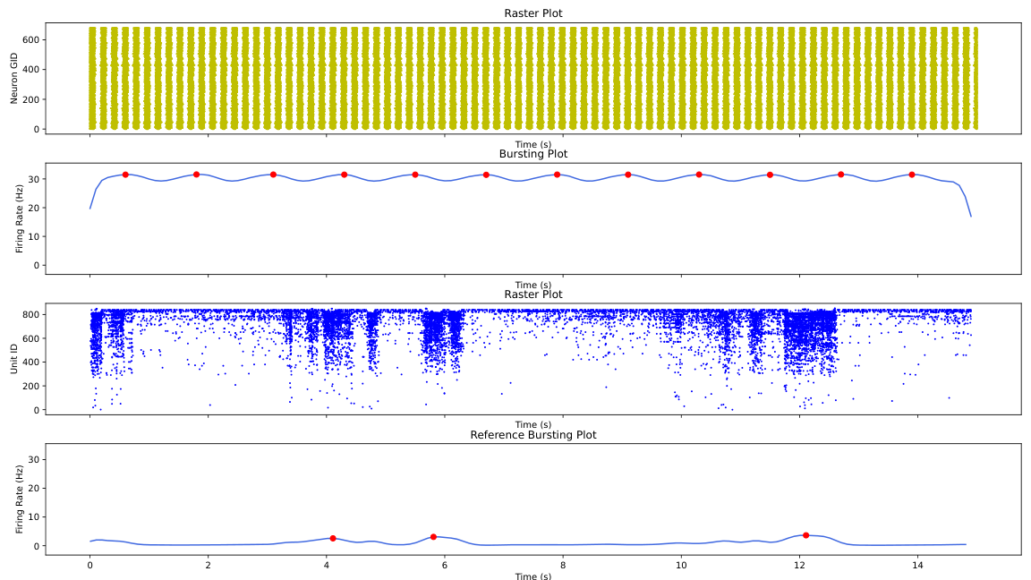
gen_1_cand_50
Candidate: gen_1_cand_50
Avg Fitness: 1000

Slide 23
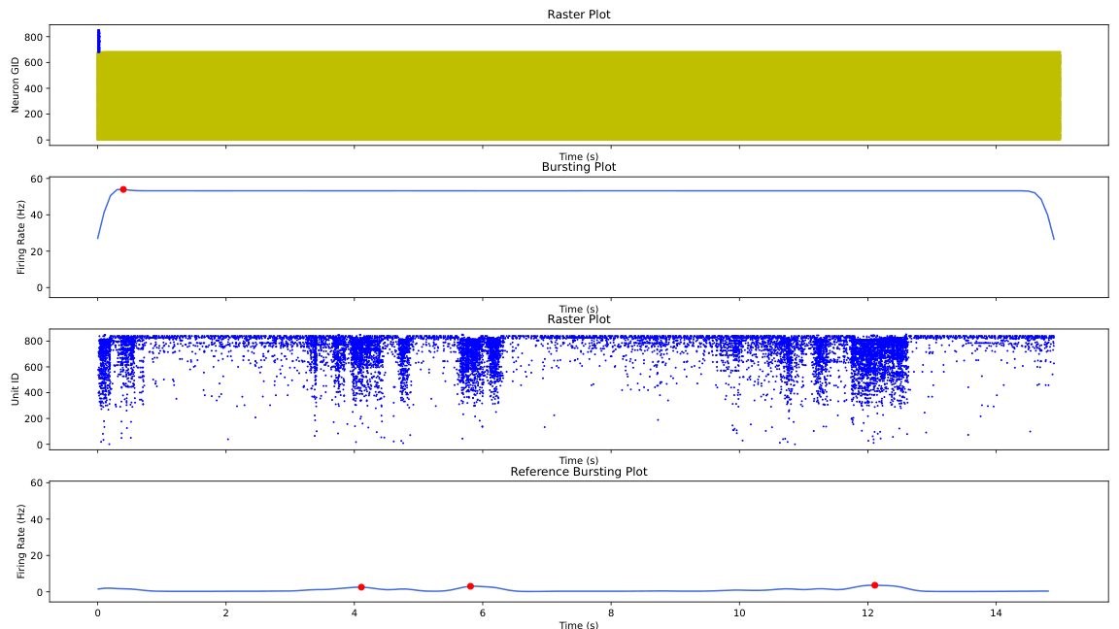
gen_1_cand_43
Candidate: gen_1_cand_43
Avg Fitness: 1000

Slide 24
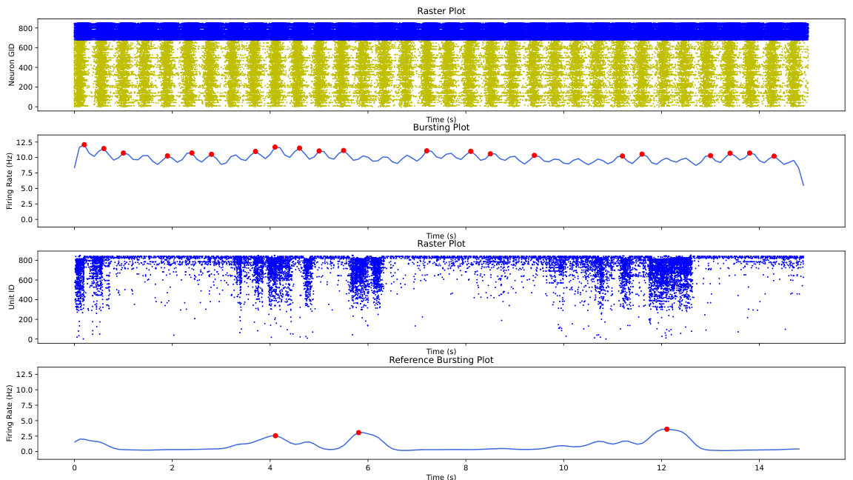
gen_1_cand_13
Candidate: gen_1_cand_13
Avg Fitness: 1000

Slide 25

gen_1_cand_12
Candidate: gen_1_cand_12
Avg Fitness: 1000

Slide 26
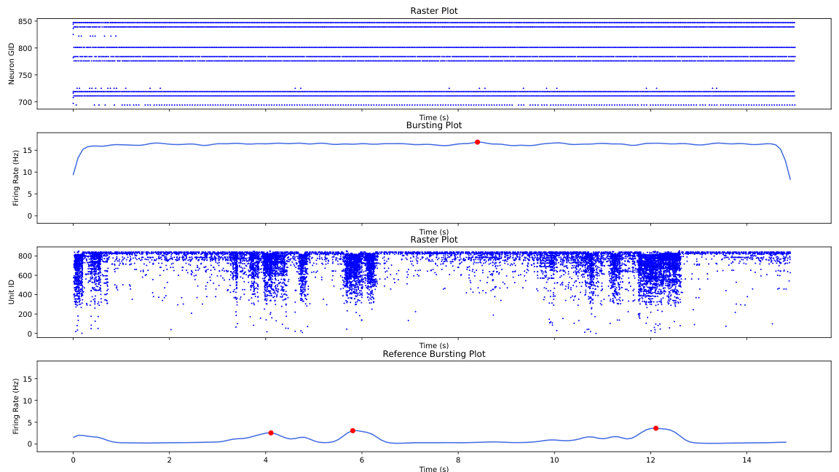
gen_1_cand_59
Candidate: gen_1_cand_59
Avg Fitness: 1000

Slide 27

gen_1_cand_56
Candidate: gen_1_cand_56
Avg Fitness: 1000

Slide 28
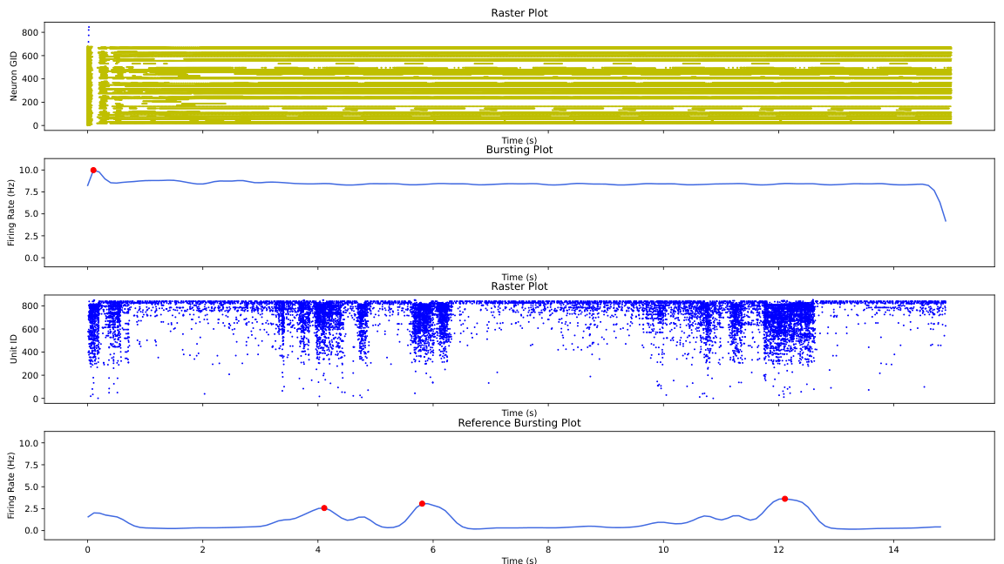
gen_1_cand_72
Candidate: gen_1_cand_72
Avg Fitness: 866.7190989675313

Slide 29

gen_1_cand_31
Candidate: gen_1_cand_31
Avg Fitness: 1000

Slide 30

gen_1_cand_52
Candidate: gen_1_cand_52
Avg Fitness: 1000

Slide 31
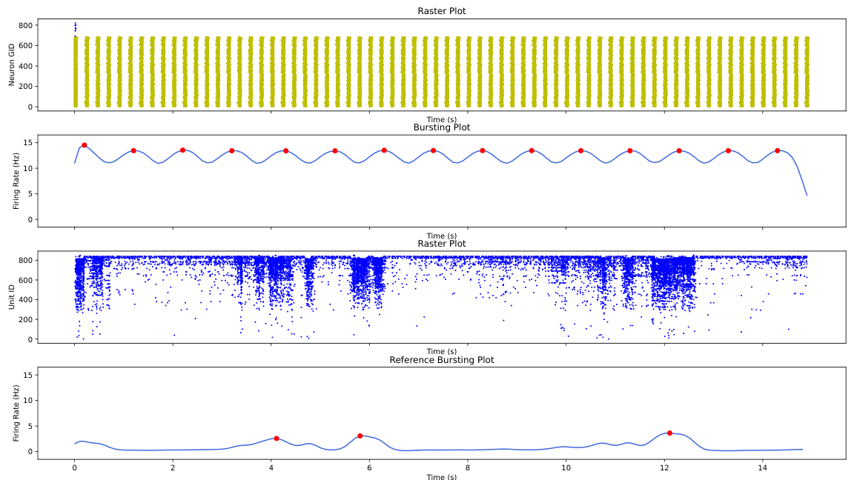
gen_1_cand_34
Candidate: gen_1_cand_34
Avg Fitness: 1000

Slide 32

gen_1_cand_29
Candidate: gen_1_cand_29
Avg Fitness: 1000

Slide 33
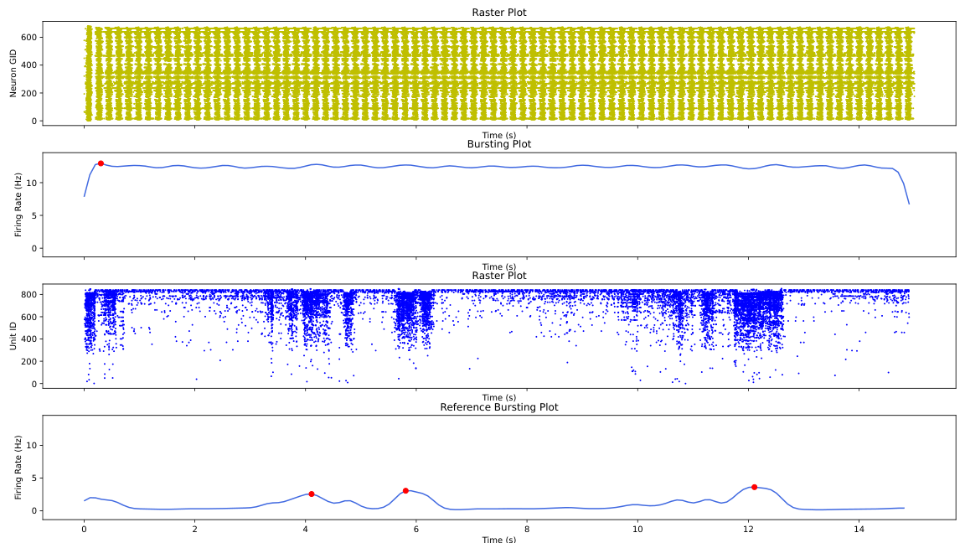
gen_1_cand_69
Candidate: gen_1_cand_69
Avg Fitness: 1000

Slide 34
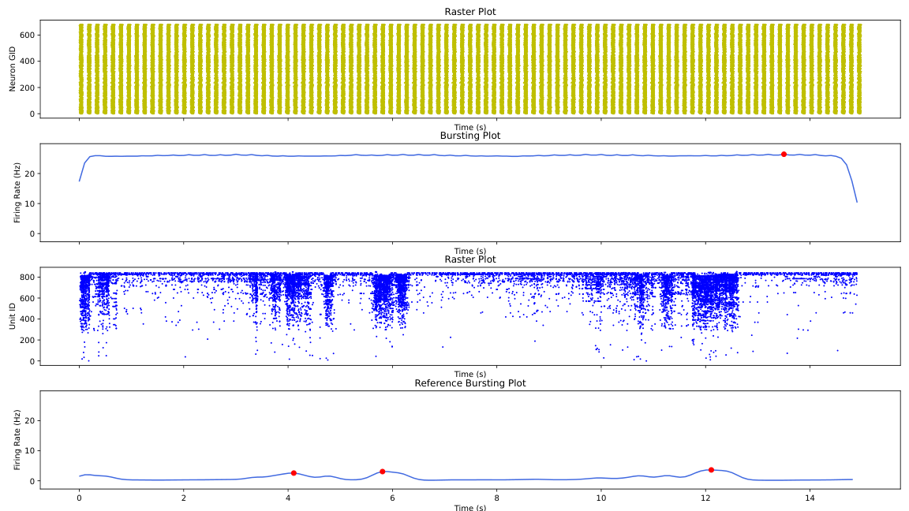
gen_1_cand_4
Candidate: gen_1_cand_4
Avg Fitness: 800.2131938651922

Slide 35
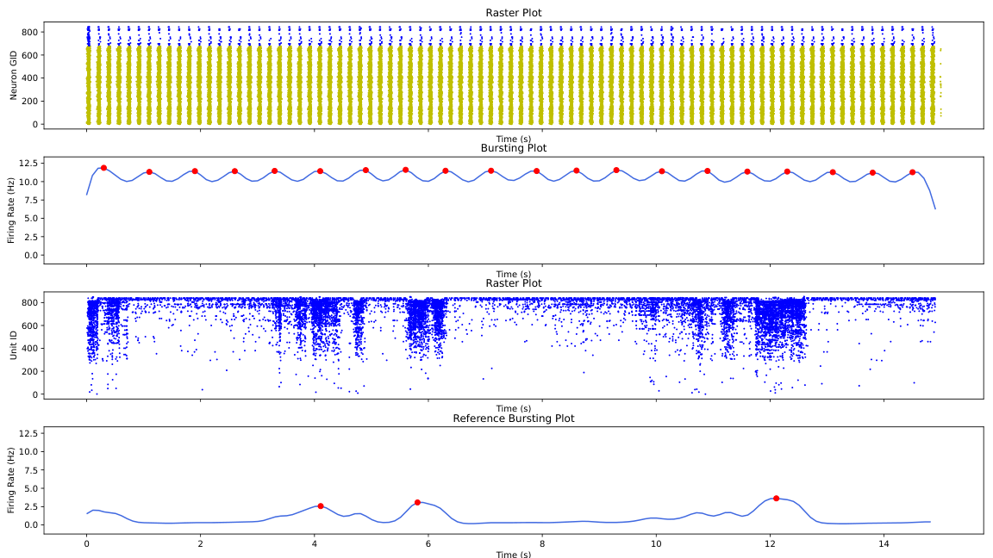
gen_1_cand_32
Candidate: gen_1_cand_32
Avg Fitness: 1000

Slide 36

gen_1_cand_79
Candidate: gen_1_cand_79
Avg Fitness: 1000

Slide 37
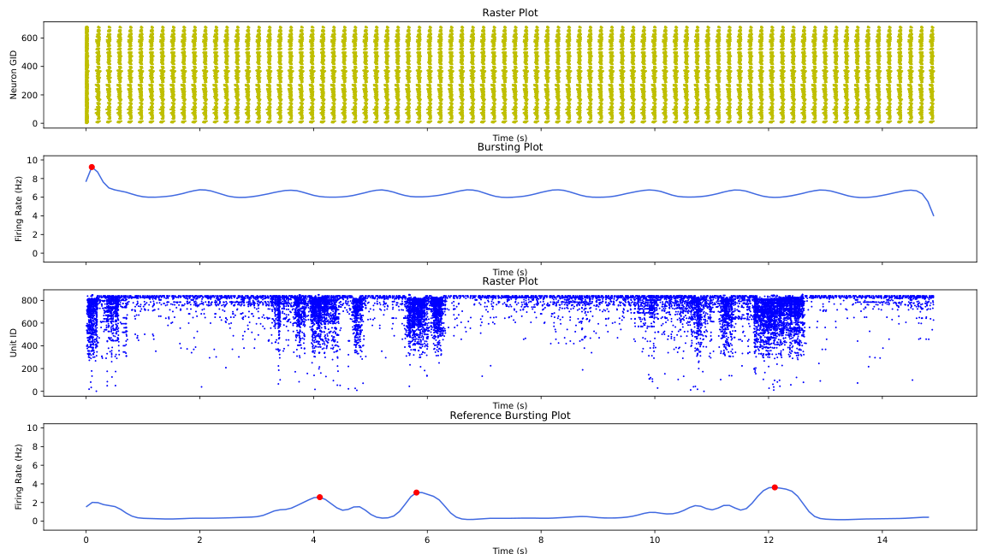
gen_1_cand_9
Candidate: gen_1_cand_9
Avg Fitness: 747.5793665707871

Slide 38
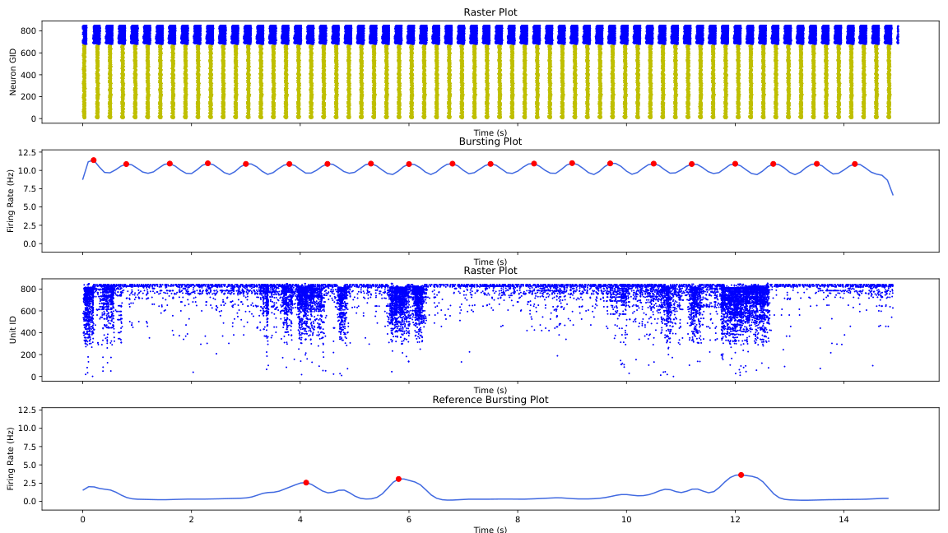
gen_1_cand_64
Candidate: gen_1_cand_64
Avg Fitness: 439.77498189482225

Slide 39

gen_1_cand_99
Candidate: gen_1_cand_99
Avg Fitness: 1000

Slide 40

gen_1_cand_27
Candidate: gen_1_cand_27
Avg Fitness: 843.9449757552838

Slide 41
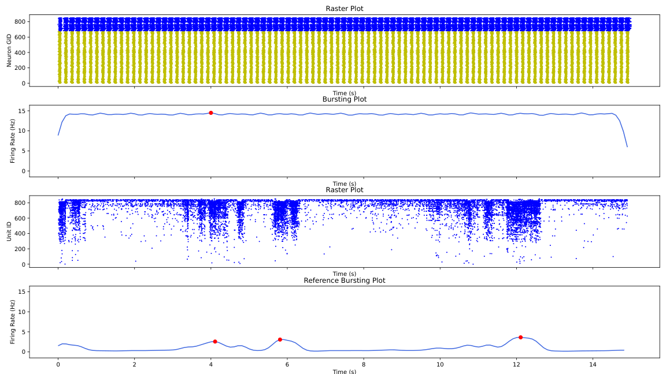
gen_1_cand_28
Candidate: gen_1_cand_28
Avg Fitness: 875.3905846020443

Slide 42

gen_1_cand_5
Candidate: gen_1_cand_5
Avg Fitness: 1000

Slide 43

gen_1_cand_88
Candidate: gen_1_cand_88
Avg Fitness: 848.30938417682

Slide 44

gen_1_cand_73
Candidate: gen_1_cand_73
Avg Fitness: 750.3509329817849

Slide 45
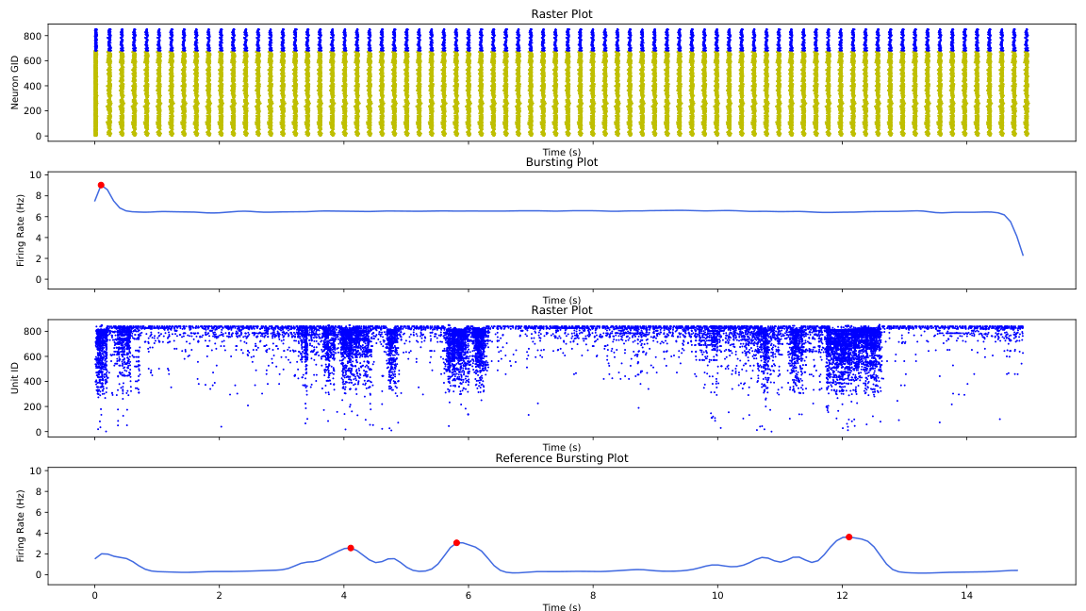
gen_1_cand_35
Candidate: gen_1_cand_35
Avg Fitness: 1000

Slide 46
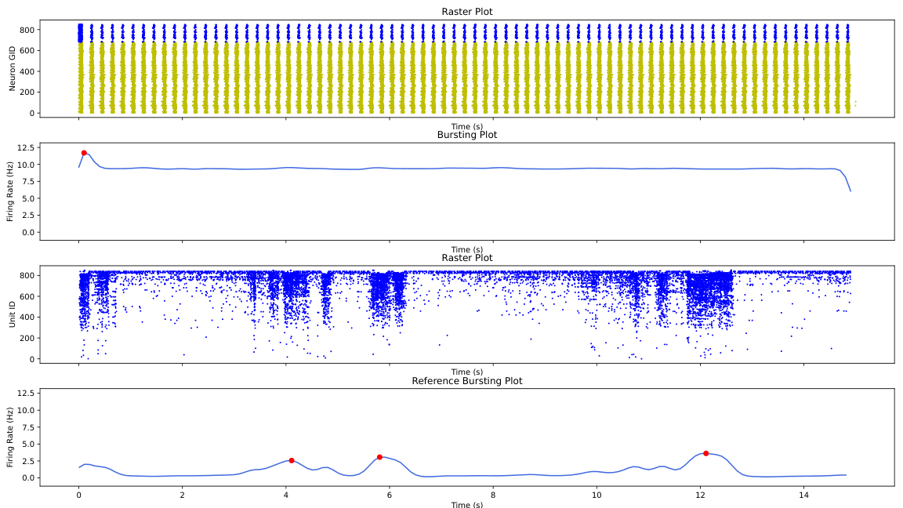
gen_1_cand_66
Candidate: gen_1_cand_66
Avg Fitness: 572.1775747305477

Slide 47
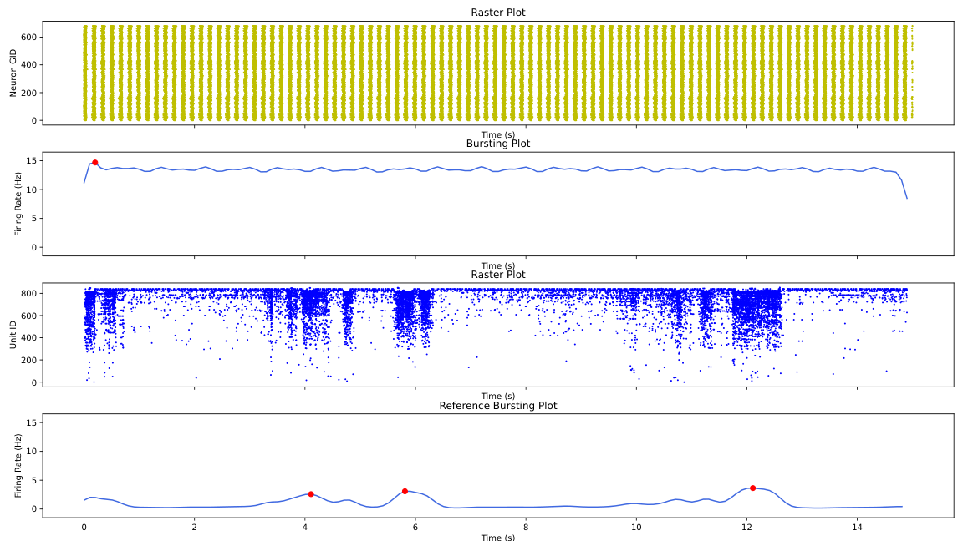
gen_1_cand_89
Candidate: gen_1_cand_89
Avg Fitness: 1000

Slide 48
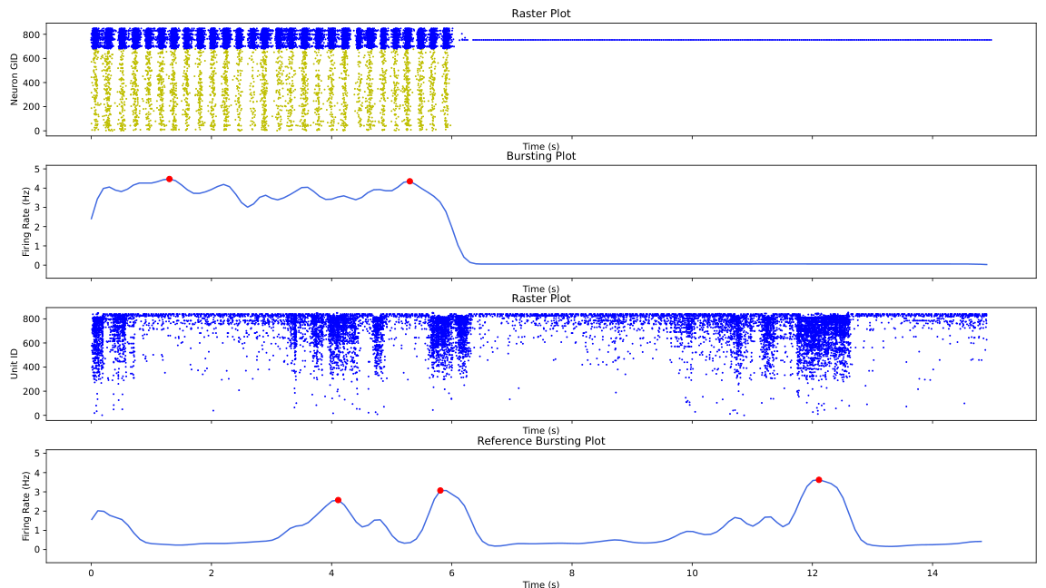
gen_1_cand_6
Candidate: gen_1_cand_6
Avg Fitness: 842.590767392772

Slide 49

gen_1_cand_30
Candidate: gen_1_cand_30
Avg Fitness: 1000

Slide 50
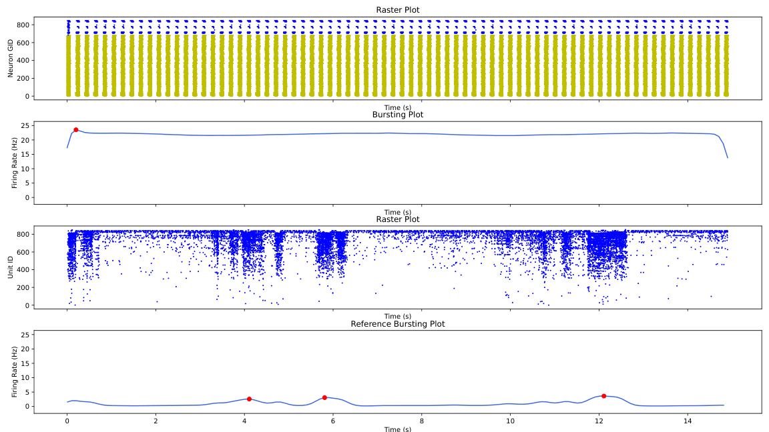
gen_1_cand_53
Candidate: gen_1_cand_53
Avg Fitness: 711.4224068903088

Slide 51

gen_1_cand_14
Candidate: gen_1_cand_14
Avg Fitness: 1000

Slide 52
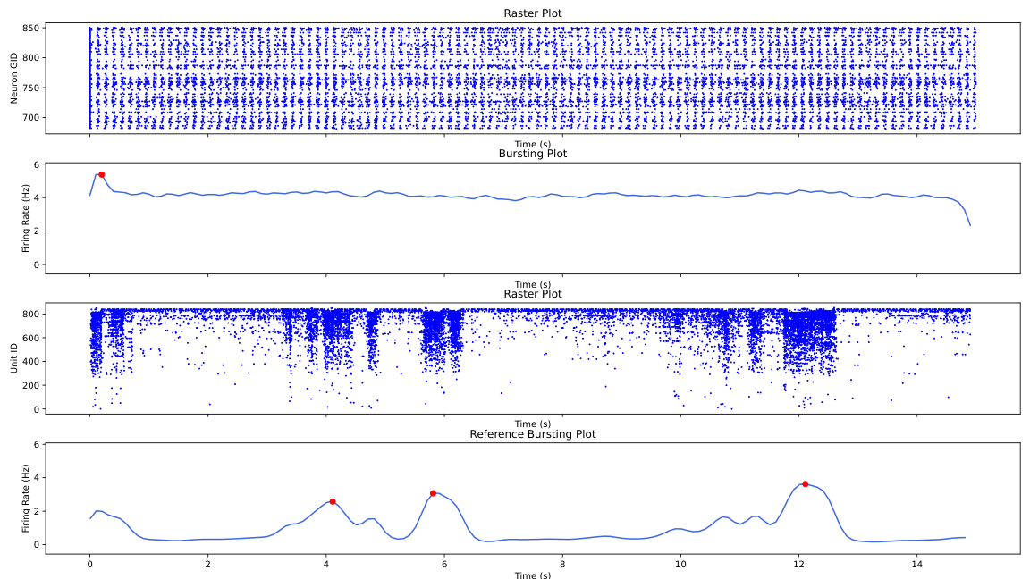
gen_1_cand_81
Candidate: gen_1_cand_81
Avg Fitness: 858.4239600011945

Slide 53
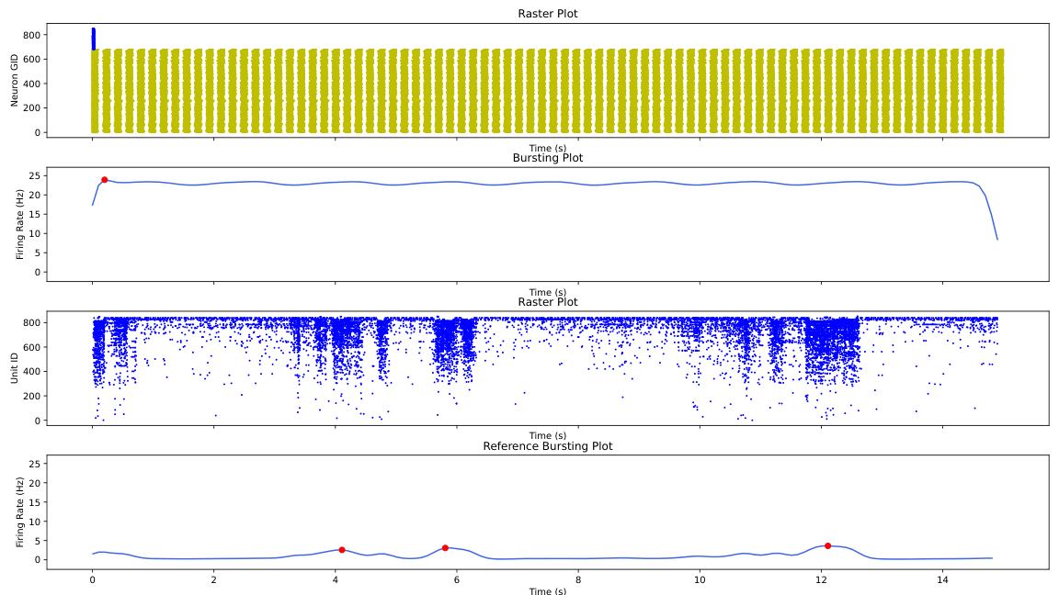
gen_1_cand_23
Candidate: gen_1_cand_23
Avg Fitness: 1000

Slide 54
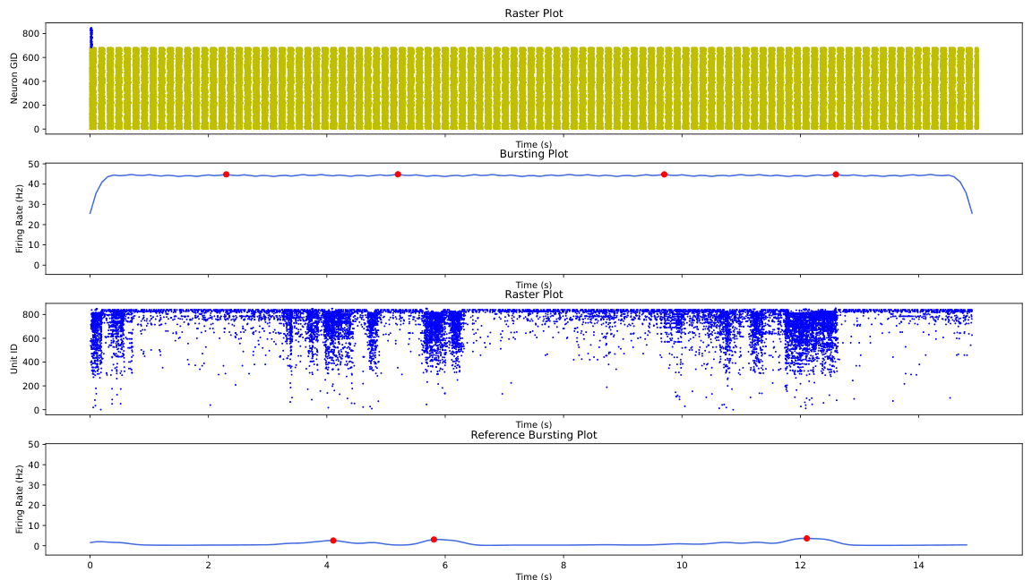
gen_1_cand_87
Candidate: gen_1_cand_87
Avg Fitness: 693.9008559502474

Slide 55

gen_1_cand_19
Candidate: gen_1_cand_19
Avg Fitness: 881.6797773085724

Slide 56

gen_1_cand_1
Candidate: gen_1_cand_1
Avg Fitness: 1000

Slide 57
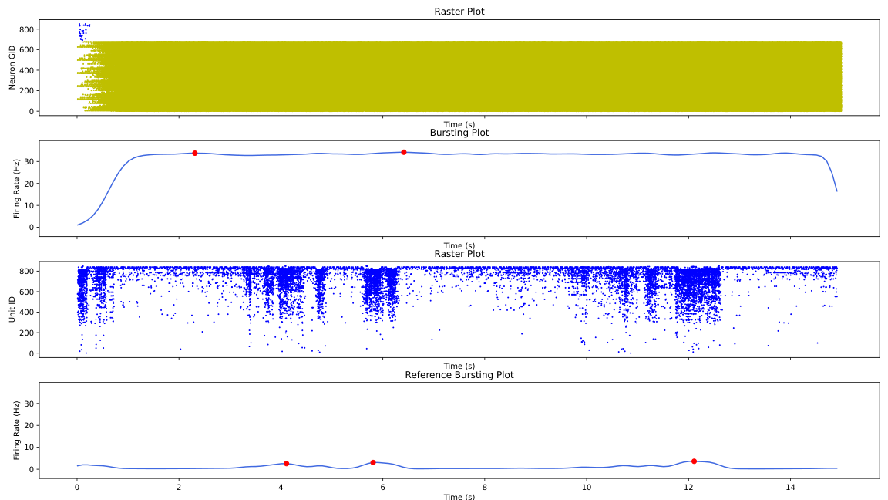
gen_1_cand_93
Candidate: gen_1_cand_93
Avg Fitness: 805.5449846627862

Slide 58

gen_1_cand_16
Candidate: gen_1_cand_16
Avg Fitness: 770.4962342956804

Slide 59
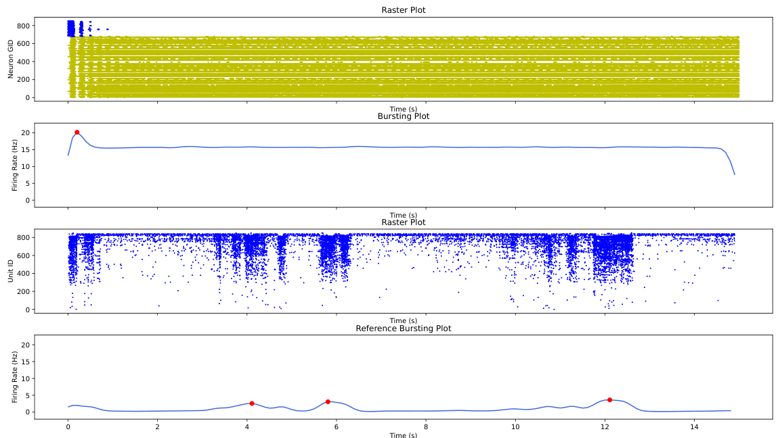
gen_1_cand_68
Candidate: gen_1_cand_68
Avg Fitness: 1000

Slide 60
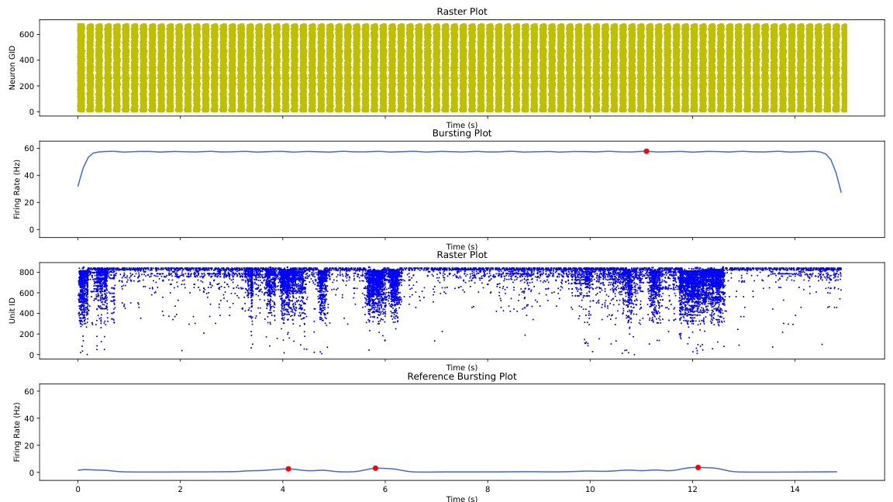
gen_1_cand_22
Candidate: gen_1_cand_22
Avg Fitness: 757.5576332856144

Slide 61
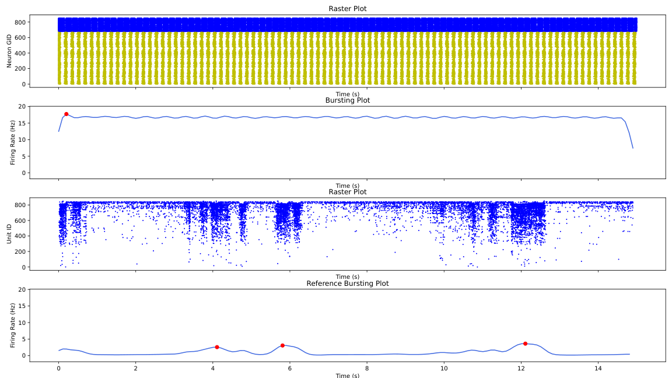
gen_1_cand_55
Candidate: gen_1_cand_55
Avg Fitness: 1000

Slide 62

gen_1_cand_3
Candidate: gen_1_cand_3
Avg Fitness: 1000

Slide 63

gen_2_cand_69
Candidate: gen_2_cand_69
Avg Fitness: 1000

Slide 64

gen_2_cand_38
Candidate: gen_2_cand_38
Avg Fitness: 1000

Slide 65

gen_2_cand_40
Candidate: gen_2_cand_40
Avg Fitness: 635.0211743081221

Slide 66

gen_2_cand_46
Candidate: gen_2_cand_46
Avg Fitness: 1000

Slide 67
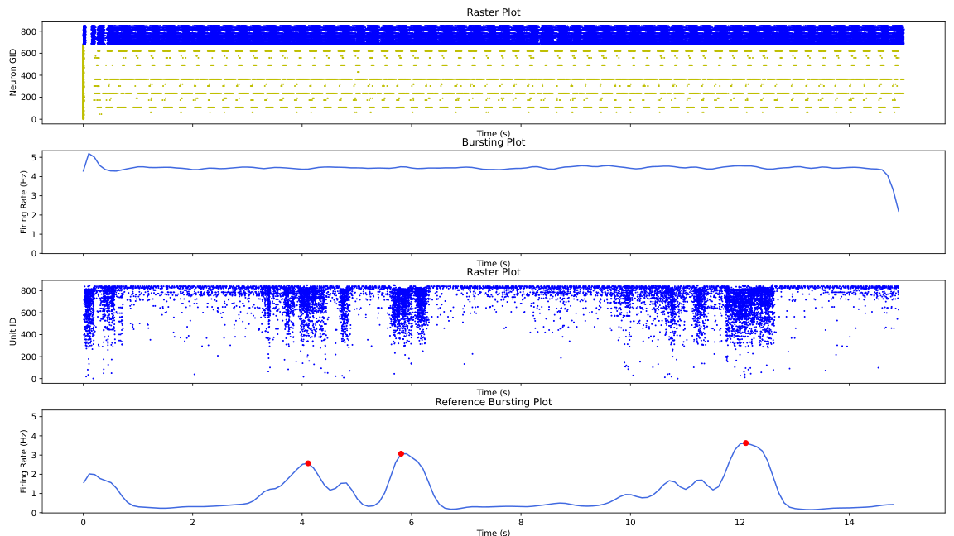
gen_2_cand_25
Candidate: gen_2_cand_25
Avg Fitness: 853.676643788923

Slide 68

gen_2_cand_89
Candidate: gen_2_cand_89
Avg Fitness: 839.0068450725104

Slide 69
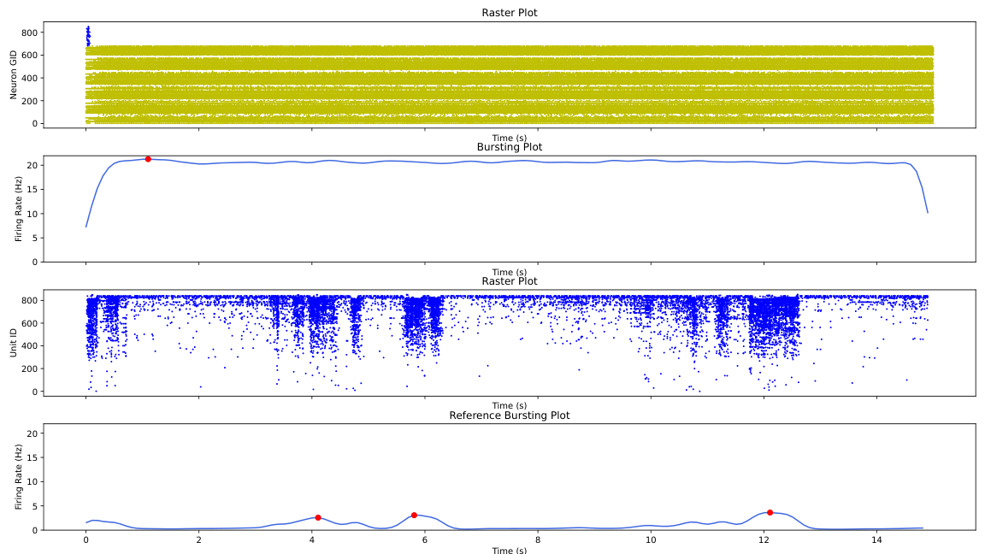
gen_2_cand_14
Candidate: gen_2_cand_14
Avg Fitness: 778.1381563216129

Slide 70

gen_2_cand_53
Candidate: gen_2_cand_53
Avg Fitness: 775.6060880306167

Slide 71

gen_2_cand_42
Candidate: gen_2_cand_42
Avg Fitness: 836.7001602494352

Slide 72

gen_2_cand_2
Candidate: gen_2_cand_2
Avg Fitness: 1000

Slide 73
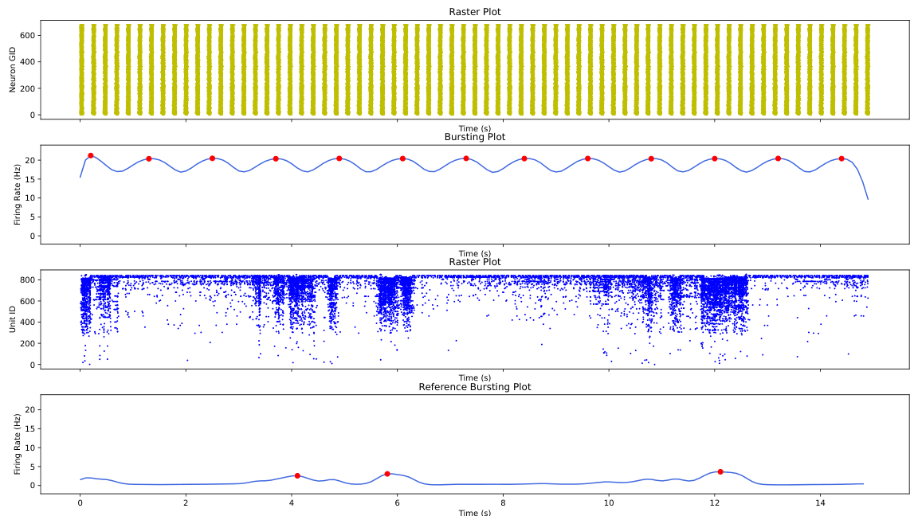
gen_2_cand_5
Candidate: gen_2_cand_5
Avg Fitness: 747.0778962349361

Slide 74
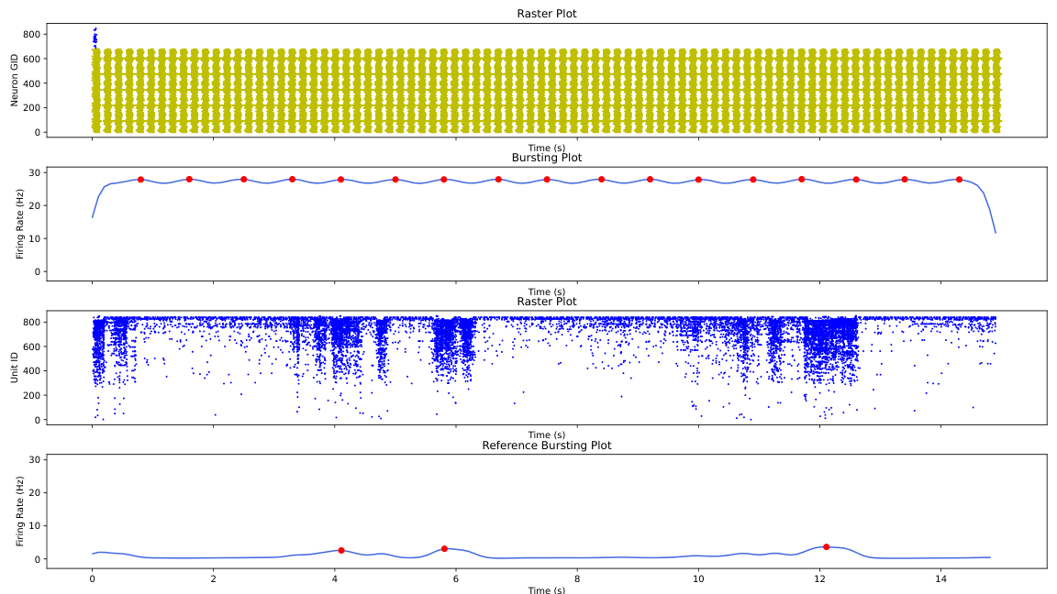
gen_2_cand_6
Candidate: gen_2_cand_6
Avg Fitness: 1000

Slide 75
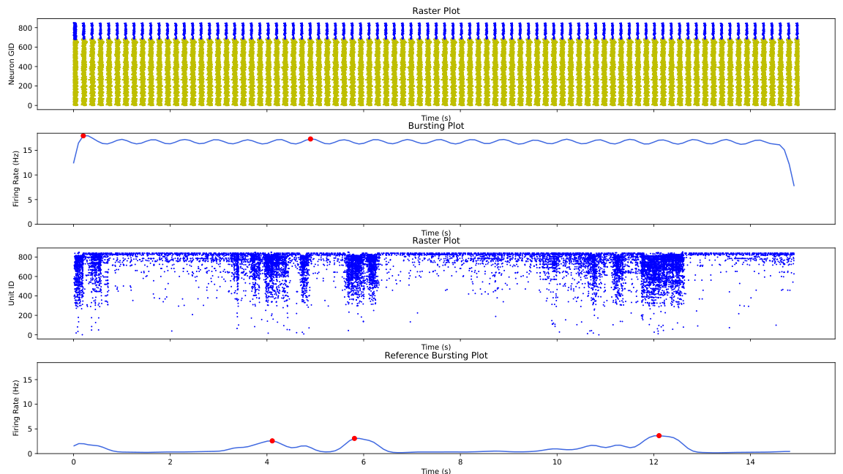
gen_2_cand_45
Candidate: gen_2_cand_45
Avg Fitness: 663.4663768814524

Slide 76

gen_2_cand_90
Candidate: gen_2_cand_90
Avg Fitness: 853.4943117864809

Slide 77

gen_2_cand_95
Candidate: gen_2_cand_95
Avg Fitness: 1000

Slide 78
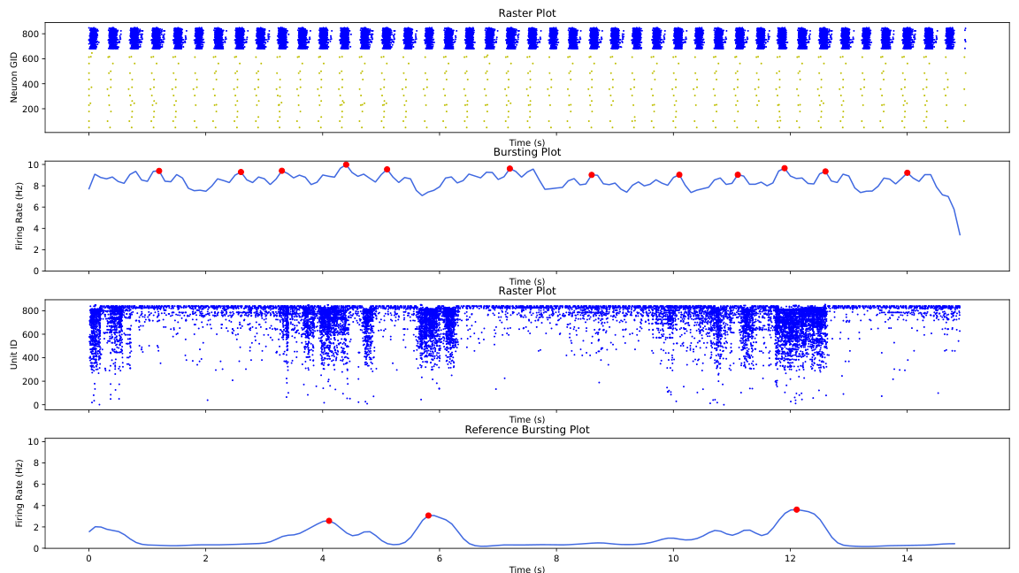
gen_2_cand_39
Candidate: gen_2_cand_39
Avg Fitness: 430.41576456669367

Slide 79
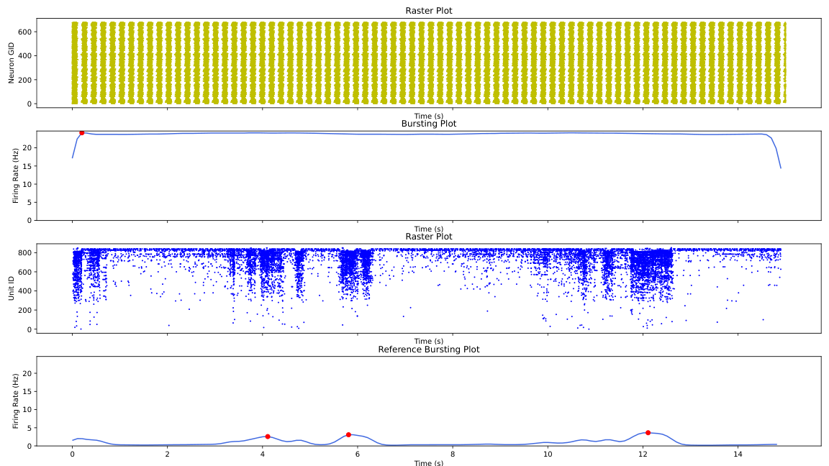
gen_2_cand_20
Candidate: gen_2_cand_20
Avg Fitness: 1000

Slide 80

gen_2_cand_52
Candidate: gen_2_cand_52
Avg Fitness: 1000

Slide 81

gen_2_cand_48
Candidate: gen_2_cand_48
Avg Fitness: 592.3957996170042

Slide 82
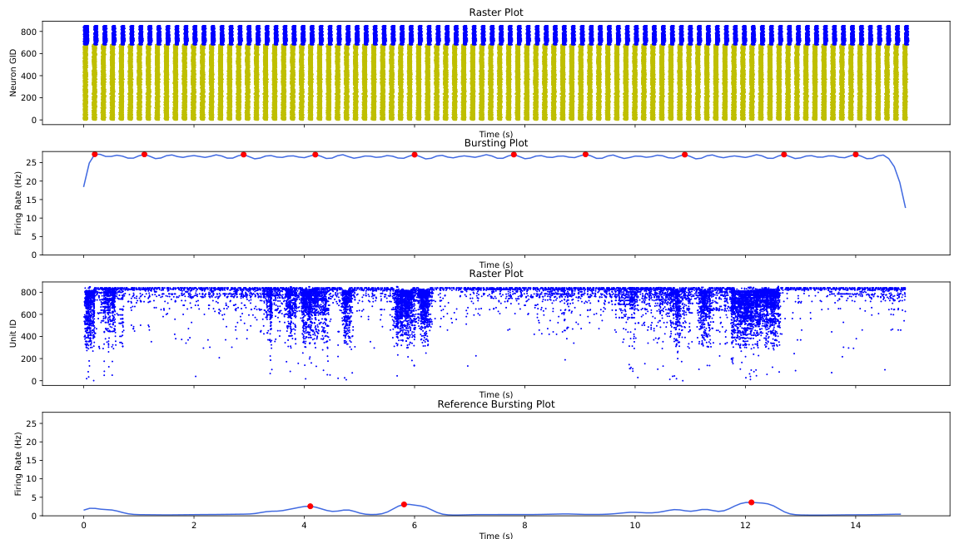
gen_2_cand_79
Candidate: gen_2_cand_79
Avg Fitness: 576.19053962087

Slide 83
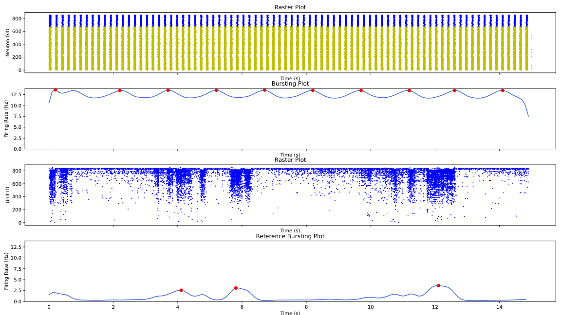
gen_2_cand_47
Candidate: gen_2_cand_47
Avg Fitness: 534.2200003366595

Slide 84

gen_2_cand_28
Candidate: gen_2_cand_28
Avg Fitness: 804.6934624173315

Slide 85
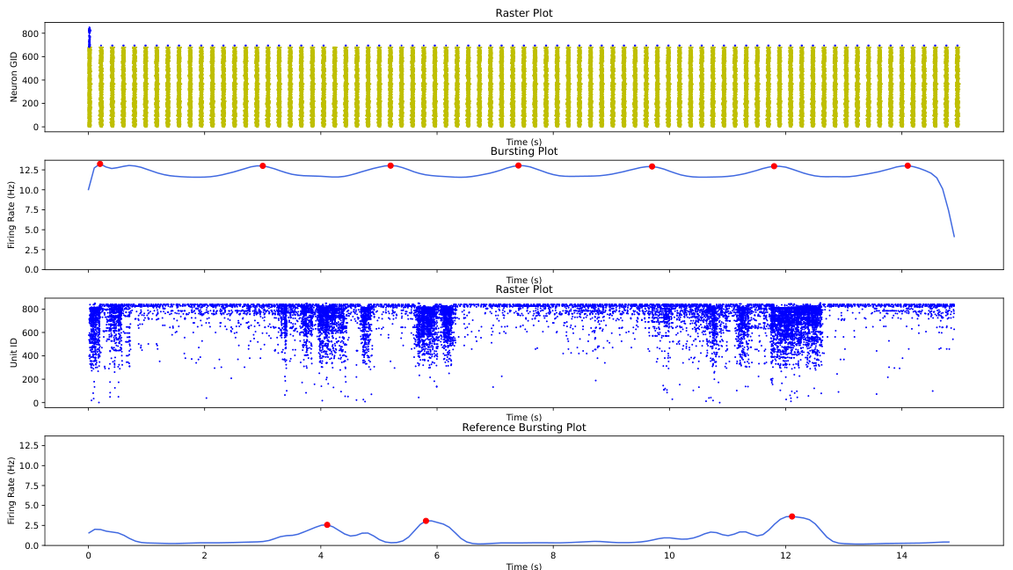
gen_2_cand_97
Candidate: gen_2_cand_97
Avg Fitness: 569.9987385290651

Slide 86

gen_2_cand_77
Candidate: gen_2_cand_77
Avg Fitness: 642.3400092512318

Slide 87

gen_2_cand_87
Candidate: gen_2_cand_87
Avg Fitness: 797.5190445609364

Slide 88

gen_2_cand_21
Candidate: gen_2_cand_21
Avg Fitness: 570.3327324782634

Slide 89

gen_2_cand_57
Candidate: gen_2_cand_57
Avg Fitness: 821.5923037648972

Slide 90

gen_2_cand_66
Candidate: gen_2_cand_66
Avg Fitness: 1000

Slide 91

gen_2_cand_31
Candidate: gen_2_cand_31
Avg Fitness: 553.3316925443479

Slide 92

gen_2_cand_64
Candidate: gen_2_cand_64
Avg Fitness: 1000

Slide 93

gen_2_cand_41
Candidate: gen_2_cand_41
Avg Fitness: 850.9979086997992

Slide 94

gen_2_cand_35
Candidate: gen_2_cand_35
Avg Fitness: 1000

Slide 95

gen_2_cand_16
Candidate: gen_2_cand_16
Avg Fitness: 1000

Slide 96

gen_2_cand_62
Candidate: gen_2_cand_62
Avg Fitness: 797.9493232970175

Slide 97

gen_2_cand_70
Candidate: gen_2_cand_70
Avg Fitness: 1000

Slide 98

gen_2_cand_44
Candidate: gen_2_cand_44
Avg Fitness: 605.0253133830853

Slide 99

gen_2_cand_32
Candidate: gen_2_cand_32
Avg Fitness: 1000

Slide 100

gen_2_cand_22
Candidate: gen_2_cand_22
Avg Fitness: 847.3942329592976

Slide 101

gen_2_cand_98
Candidate: gen_2_cand_98
Avg Fitness: 741.0418070483313

Slide 102

gen_2_cand_96
Candidate: gen_2_cand_96
Avg Fitness: 1000

Slide 103

gen_2_cand_73
Candidate: gen_2_cand_73
Avg Fitness: 824.8617461073991

Slide 104

gen_2_cand_3
Candidate: gen_2_cand_3
Avg Fitness: 786.6849533866316

Slide 105

gen_2_cand_94
Candidate: gen_2_cand_94
Avg Fitness: 1000

Slide 106

gen_2_cand_18
Candidate: gen_2_cand_18
Avg Fitness: N/A

Slide 107

gen_2_cand_78
Candidate: gen_2_cand_78
Avg Fitness: 1000

Slide 108

gen_2_cand_10
Candidate: gen_2_cand_10
Avg Fitness: 1000

Slide 109

gen_2_cand_24
Candidate: gen_2_cand_24
Avg Fitness: 746.9033002564174

Slide 110

gen_2_cand_23
Candidate: gen_2_cand_23
Avg Fitness: 794.2424520727238

Slide 111

gen_2_cand_0
Candidate: gen_2_cand_0
Avg Fitness: 541.9559338510745

Slide 112

gen_2_cand_99
Candidate: gen_2_cand_99
Avg Fitness: 688.9482497943234

Slide 113

gen_2_cand_76
Candidate: gen_2_cand_76
Avg Fitness: 1000

Slide 114

gen_2_cand_74
Candidate: gen_2_cand_74
Avg Fitness: 1000

Slide 115

gen_2_cand_37
Candidate: gen_2_cand_37
Avg Fitness: 787.2586963089952

Slide 116

gen_2_cand_27
Candidate: gen_2_cand_27
Avg Fitness: 828.2345393196267

Slide 117

gen_2_cand_80
Candidate: gen_2_cand_80
Avg Fitness: 748.8828594709689

Slide 118

gen_2_cand_71
Candidate: gen_2_cand_71
Avg Fitness: 537.7768059110829

Slide 119

gen_2_cand_12
Candidate: gen_2_cand_12
Avg Fitness: 1000

Slide 120

gen_2_cand_56
Candidate: gen_2_cand_56
Avg Fitness: 590.7645629427461

Slide 121

gen_2_cand_29
Candidate: gen_2_cand_29
Avg Fitness: 801.165162149719

Slide 122

gen_2_cand_75
Candidate: gen_2_cand_75
Avg Fitness: 736.3485258222272

Slide 123

gen_2_cand_82
Candidate: gen_2_cand_82
Avg Fitness: 1000

Slide 124

gen_2_cand_15
Candidate: gen_2_cand_15
Avg Fitness: N/A

Slide 125

gen_2_cand_17
Candidate: gen_2_cand_17
Avg Fitness: 827.3564855059203

Slide 126

gen_2_cand_13
Candidate: gen_2_cand_13
Avg Fitness: 664.7101401783389

Slide 127

gen_2_cand_60
Candidate: gen_2_cand_60
Avg Fitness: 501.3687334283172

Slide 128

gen_4_cand_9
Candidate: gen_4_cand_9
Avg Fitness: N/A

Slide 129

gen_4_cand_91
Candidate: gen_4_cand_91
Avg Fitness: N/A

Slide 130

gen_4_cand_57
Candidate: gen_4_cand_57
Avg Fitness: 560.6632869777217

Slide 131

gen_4_cand_81
Candidate: gen_4_cand_81
Avg Fitness: 1000

Slide 132

gen_4_cand_1
Candidate: gen_4_cand_1
Avg Fitness: 576.0393773877445

Slide 133

gen_4_cand_39
Candidate: gen_4_cand_39
Avg Fitness: N/A

Slide 134

gen_4_cand_48
Candidate: gen_4_cand_48
Avg Fitness: N/A

Slide 135

gen_4_cand_38
Candidate: gen_4_cand_38
Avg Fitness: N/A

Slide 136

gen_4_cand_3
Candidate: gen_4_cand_3
Avg Fitness: 1000

Slide 137

gen_4_cand_70
Candidate: gen_4_cand_70
Avg Fitness: 854.8335442911566

Slide 138

gen_4_cand_69
Candidate: gen_4_cand_69
Avg Fitness: N/A

Slide 139

gen_4_cand_72
Candidate: gen_4_cand_72
Avg Fitness: 554.4734353334901

Slide 140

gen_4_cand_54
Candidate: gen_4_cand_54
Avg Fitness: N/A

Slide 141

gen_4_cand_64
Candidate: gen_4_cand_64
Avg Fitness: 1000

Slide 142

gen_4_cand_79
Candidate: gen_4_cand_79
Avg Fitness: 744.9871755401199

Slide 143

gen_4_cand_71
Candidate: gen_4_cand_71
Avg Fitness: 755.9513626829544

